Slide 1
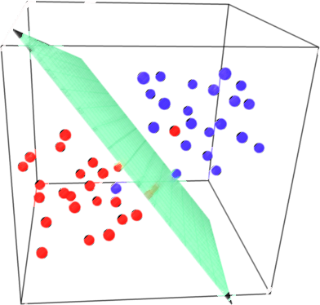

Lecture 17: Support Vector Machine (SVM) (Part II)
CSE445 Machine Learning
Dr. Jilan Samiuddin (JSA)
Assistant Professor
North South University

Slide 2
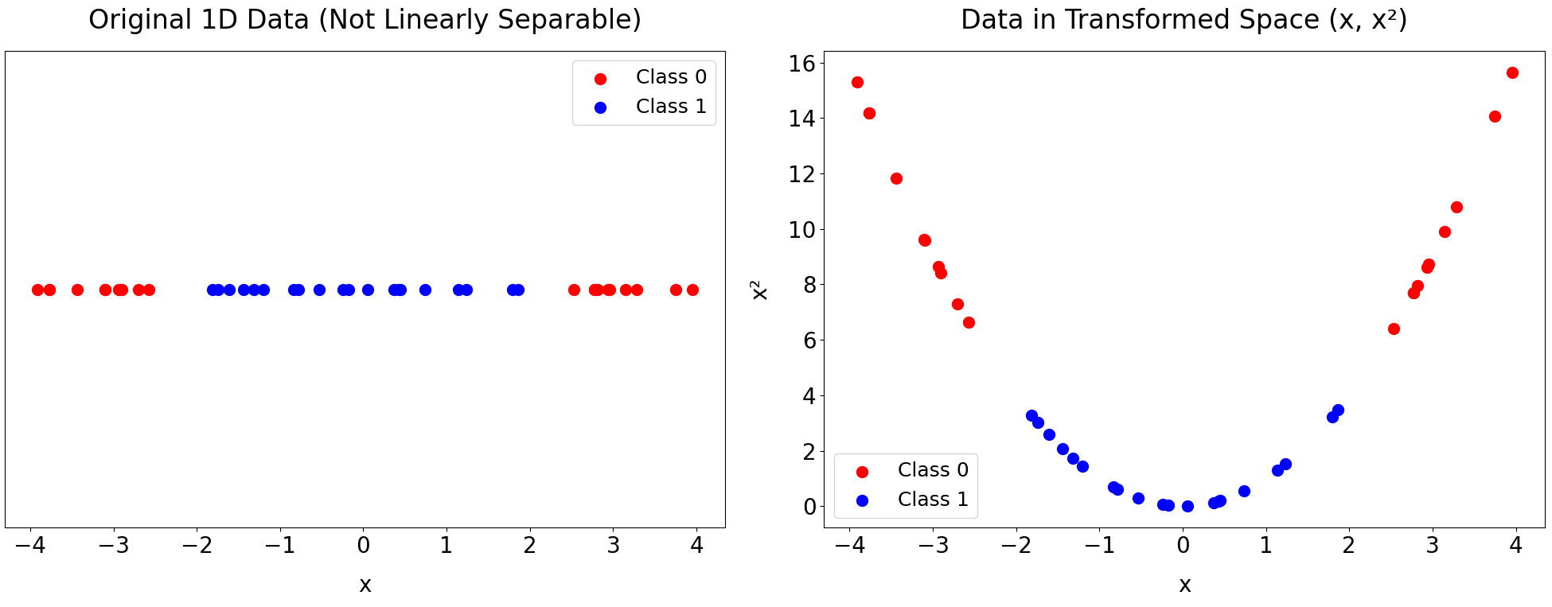
Case 3: Not Linearly Separable Data – Kernel Trick
Key Idea: Map input data into a higher-dimensional space where it becomes linearly separable
In this example: $∅:ℝ→ℝ^{2}$ to transform 1D data to 2D data, more particularly: $∅\left(x\right)=\left(x,x^{2}\right)$
Decision Boundary
Medicine Dosage,
Data is now linearly separable in the transformed feature space
Data is not linearly separable in the input space

Slide 3
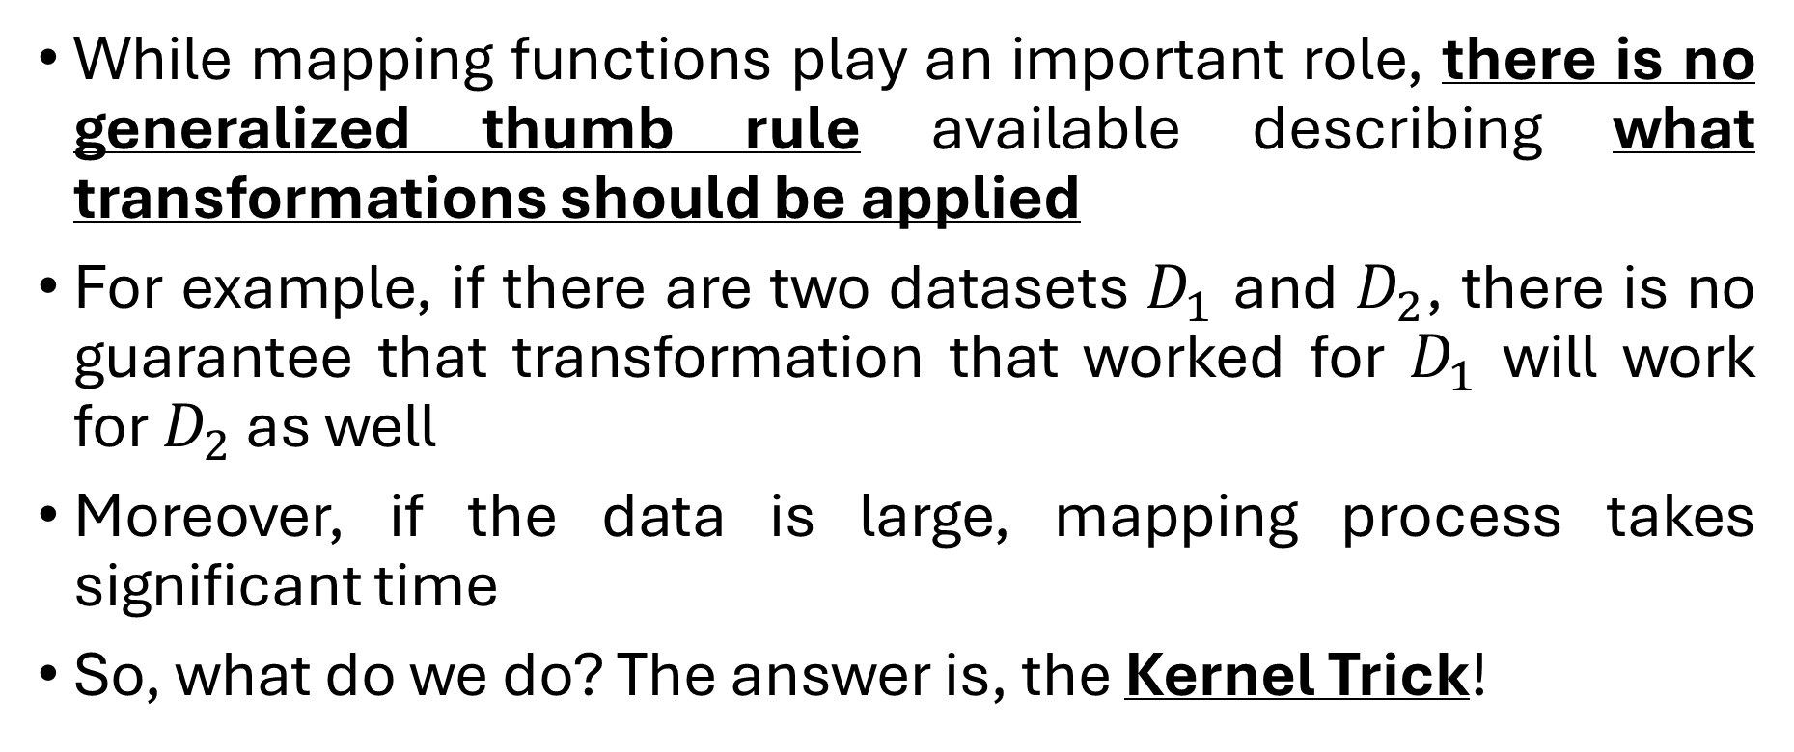
Case 3: Kernel Trick (contd.)
While mapping functions play an important role, there is no generalized thumb rule available describing what transformations should be applied
For example, if there are two datasets $D_{1}$ and $D_{2}$, there is no guarantee that transformation that worked for $D_{1}$ will work for $D_{2}$ as well
Moreover, if the data is large, mapping process takes significant time
So, what do we do? The answer is, the Kernel Trick!

Slide 4
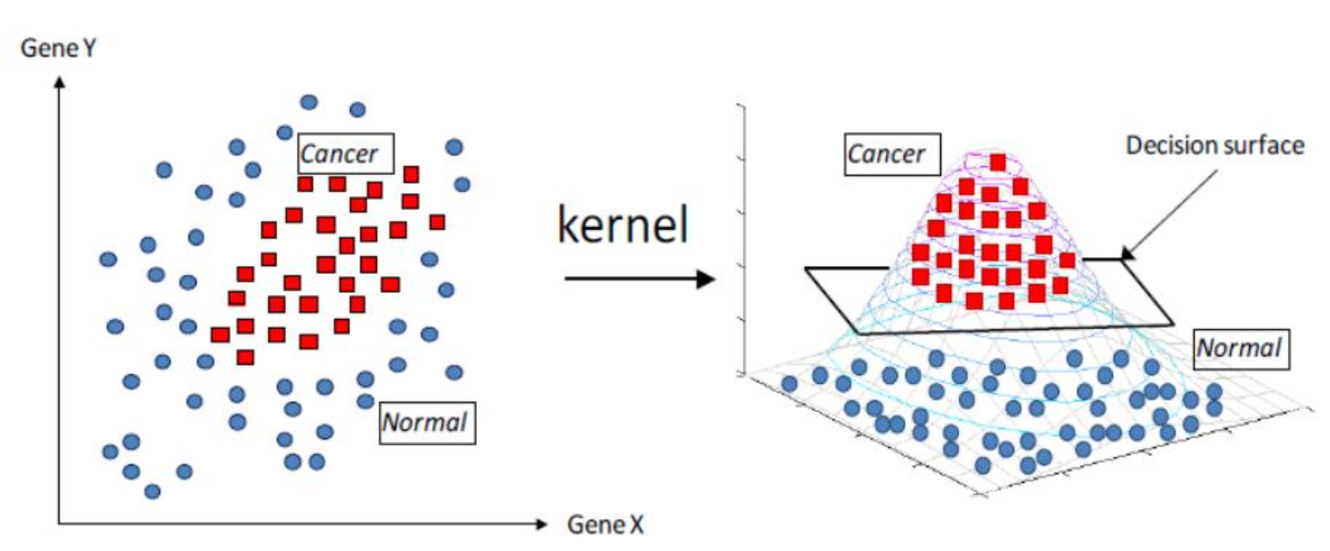
Case 3: Kernel Trick (contd.)
What is Kernel?
Kernels are set of functions used to transform data from lower dimension to higher dimension and to manipulate data using dot product at higher dimensions
Once the higher dimension data is obtained, apply SVM for classification

Slide 5
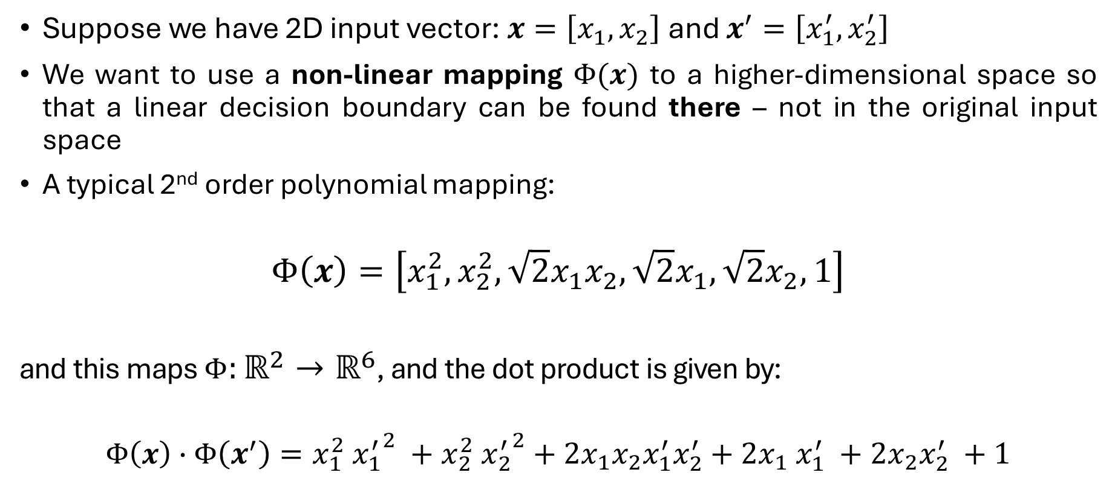
Kernel Trick: 2nd Order Degree Polynomial Mapping
Suppose we have 2D input vector: $x=\left[x_{1},x_{2}\right]$ and $x^{′}=\left[x_{1}^{′},x_{2}^{′}\right]$
We want to use a non-linear mapping $Φ(x)$ to a higher-dimensional space so that a linear decision boundary can be found there – not in the original input space
A typical 2nd order polynomial mapping:
$$Φ\left(x\right)=\left[x_{1}^{2}, x_{2}^{2}, \sqrt{2}x_{1}x_{2},\sqrt{2}x_{1},\sqrt{2}x_{2}, 1\right]$$
and this maps $Φ:ℝ^{2}→ℝ^{6}$, and the dot product is given by:
$$Φ\left(x\right)∙Φ\left(x^{′}\right)=x_{1}^{2}​ {x_{1}^{′}}^{2} +x_{2}^{2}​ {x_{2}^{′}}^{2}+2x_{1}x_{2}x_{1}^{′}x_{2}^{′}+2x_{1}​ x_{1}^{′}​ +2x_{2}​x_{2}^{′} +1$$

Slide 6
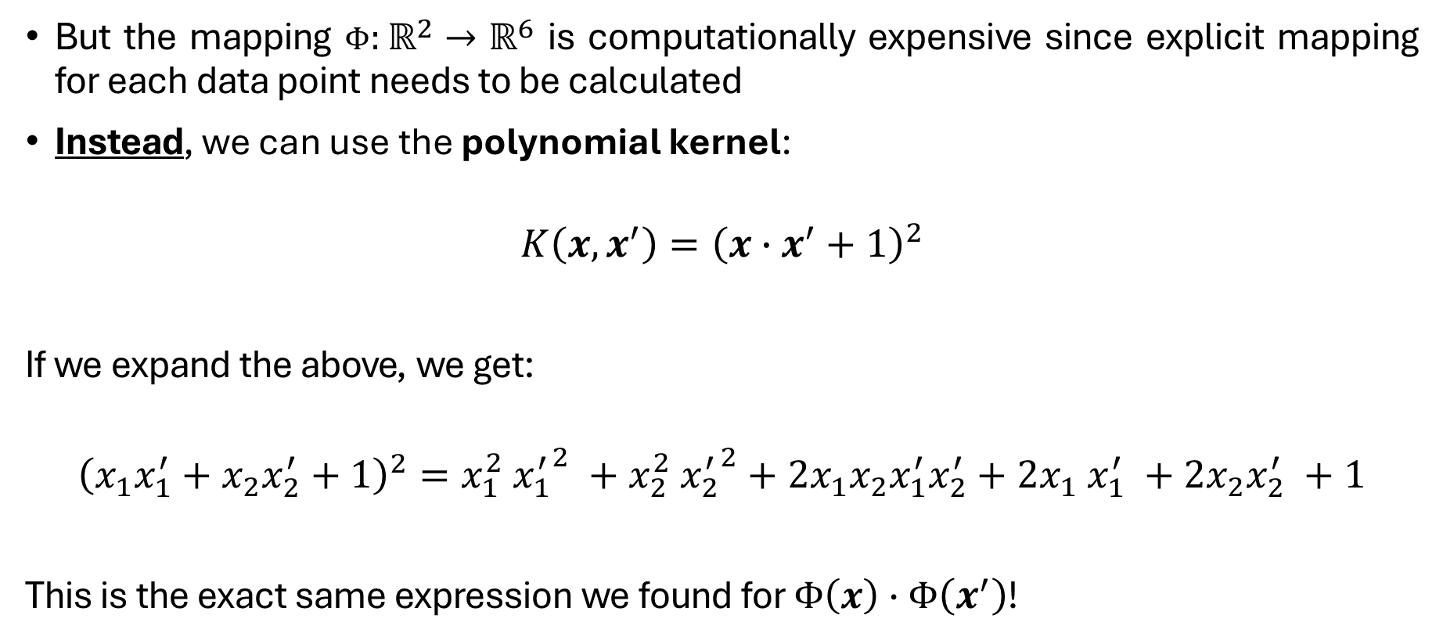
Kernel Trick: 2nd Order Degree Polynomial (contd.)
But the mapping $Φ:ℝ^{2}→ℝ^{6}$ is computationally expensive since explicit mapping for each data point needs to be calculated
Instead, we can use the polynomial kernel:
$$K\left(x,x^{′}\right)={\left(x∙x^{′}+1\right)}^{2}$$
If we expand the above, we get:
$${\left(x_{1}x_{1}^{′}+x_{2}x_{2}^{′}+1\right)}^{2}=x_{1}^{2}​ {x_{1}^{′}}^{2} +x_{2}^{2}​ {x_{2}^{′}}^{2}+2x_{1}x_{2}x_{1}^{′}x_{2}^{′}+2x_{1}​ x_{1}^{′}​ +2x_{2}​x_{2}^{′} +1$$
This is the exact same expression we found for $Φ\left(x\right)∙Φ\left(x^{′}\right)$!

Slide 7
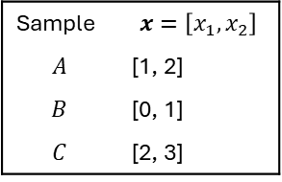
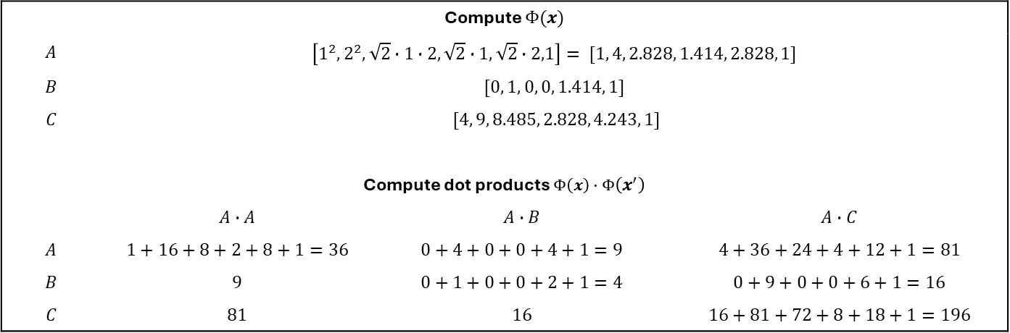
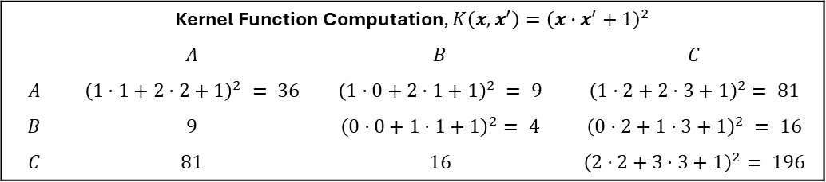
Mathematical Example: Kernel Trick 2nd Degree Poly.
Sample | $$x=\left[x_{1},x_{2}\right]$$
$$A$$ | [1, 2]
$$B$$ | [0, 1]
$$C$$ | [2, 3]
Compute $Φ(x)$
$$A$$ | $$\left[1^{2},2^{2},\sqrt{2}∙1∙2,\sqrt{2}∙1,\sqrt{2}∙2,1\right]= [1, 4, 2.828, 1.414, 2.828, 1]$$
$$B$$ | $$[0, 1, 0, 0, 1.414, 1]$$
$$C$$ | $$[4, 9, 8.485, 2.828, 4.243, 1]$$
Compute dot products $Φ\left(x\right)∙Φ\left(x^{′}\right)$
 | $$A∙A$$ | $$A∙B$$ | $$A∙C$$
$$A$$ | $$1+16+8+2+8+1=36$$ | $$0+4+0+0+4+1=9$$ | $$4+36+24+4+12+1=81$$
$$B$$ | $$9$$ | $$0+1+0+0+2+1=4$$ | $$0+9+0+0+6+1=16$$
$$C$$ | $$81$$ | $$16$$ | $$16+81+72+8+18+1=196$$
Explicit Polynomial Mapping
Kernel Function Computation, $K\left(x,x^{′}\right)={\left(x∙x^{′}+1\right)}^{2}$
 | $$A$$ | $$B$$ | $$C$$
$$A$$ | $${\left(1⋅1+2⋅2+1\right)}^{2} = 36$$ | $${\left(1⋅0+2⋅1+1\right)}^{2} = 9$$ | $${\left(1⋅2+2⋅3+1\right)}^{2}= 81$$
$$B$$ | $$9$$ | $${\left(0⋅0+1⋅1+1\right)}^{2}= 4$$ | $${\left(0⋅2+1⋅3+1\right)}^{2} = 16$$
$$C$$ | $$81$$ | $$16$$ | $${\left(2⋅2+3⋅3+1\right)}^{2}= 196$$
For larger datasets or complex kernels (like RBF or high-degree polynomials), explicit mapping becomes infeasible.
Kernel Function Computation

Slide 8
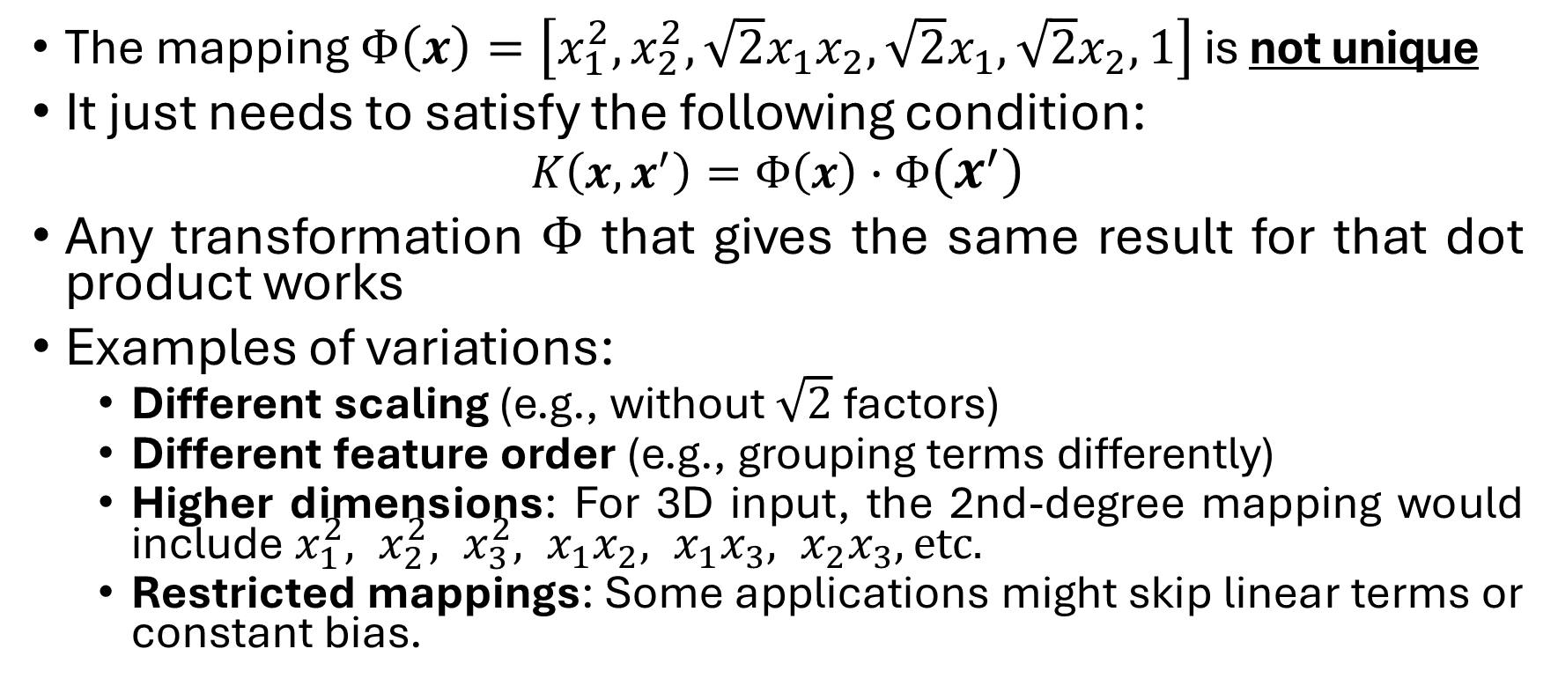
Is the 2nd Order Polynomial Mapping Unique?
The mapping $Φ\left(x\right)=\left[x_{1}^{2}, x_{2}^{2}, \sqrt{2}x_{1}x_{2},\sqrt{2}x_{1},\sqrt{2}x_{2}, 1\right]$ is not unique
It just needs to satisfy the following condition:
$$K\left(x,x^{′}\right)=Φ\left(x\right)∙Φ\left(x^{′}\right)$$
Any transformation $Φ$ that gives the same result for that dot product works
Examples of variations:
Different scaling (e.g., without $\sqrt{2}$ ​factors)
Different feature order (e.g., grouping terms differently)
Higher dimensions: For 3D input, the 2nd-degree mapping would include $x_{1}^{2}, x_{2}^{2}, x_{3}^{2}, x_{1}x_{2}, x_{1}x_{3}, x_{2}x_{3}, etc.$
Restricted mappings: Some applications might skip linear terms or constant bias.

Slide 9
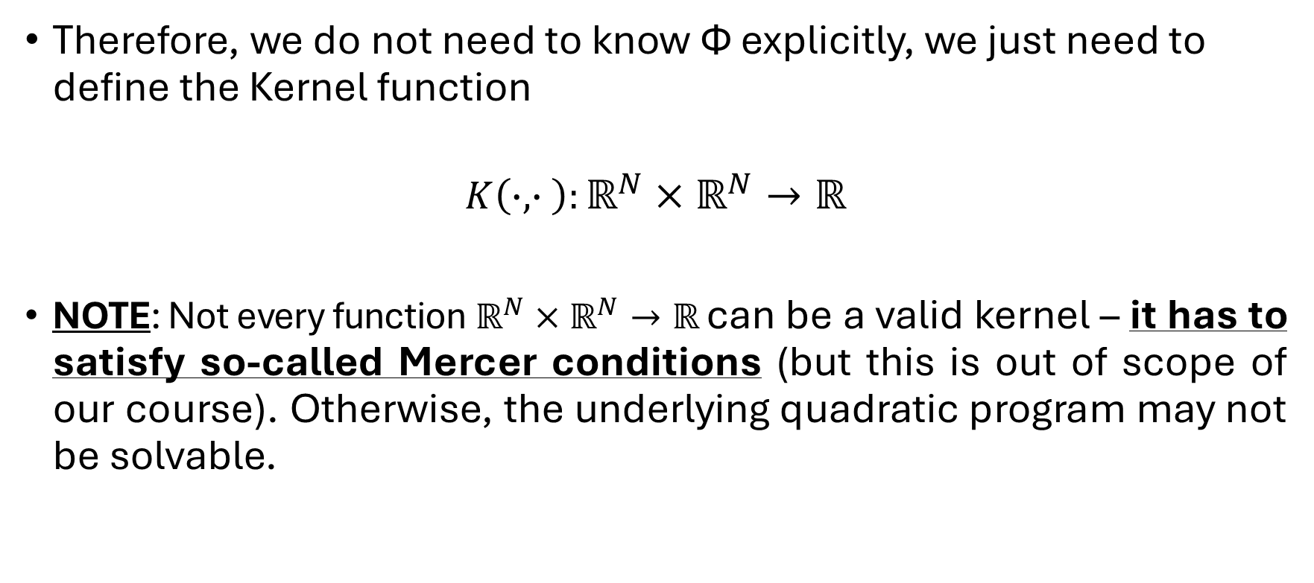
Kernel Trick Summary
Therefore, we do not need to know Ф explicitly, we just need to define the Kernel function
$$K\left(∙, ∙ \right):ℝ^{N}×ℝ^{N}→ℝ$$
NOTE: Not every function $ℝ^{N}×ℝ^{N}→ℝ$ can be a valid kernel – it has to satisfy so-called Mercer conditions (but this is out of scope of our course). Otherwise, the underlying quadratic program may not be solvable.

Slide 10
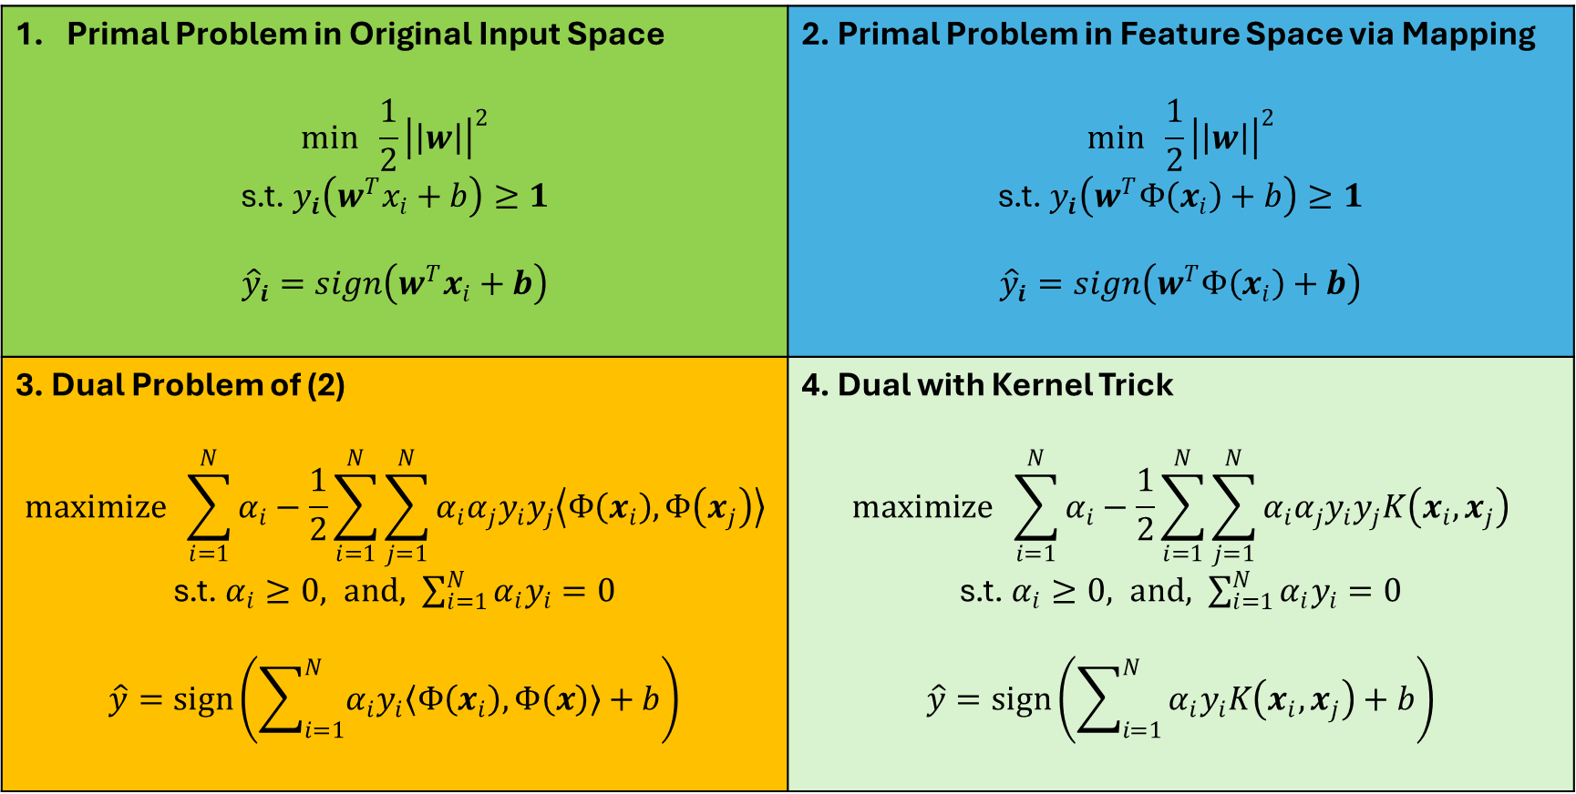
Kernel Trick Summary (contd.)
Primal Problem in Original Input Space $$min \frac{1}{2}{\left|\left|w\right|\right|}^{2}$$ s.t. $y_{i}\left(w^{T}x_{i}+b\right)≥1$ $${\hat{y}}_{i}=sign\left(w^{T}x_{i}+b\right)$$ | 2. Primal Problem in Feature Space via Mapping $$min \frac{1}{2}{\left|\left|w\right|\right|}^{2}$$ s.t. $y_{i}\left(w^{T}Φ\left(x_{i}\right)+b\right)≥1$ $${\hat{y}}_{i}=sign\left(w^{T}Φ\left(x_{i}\right)+b\right)$$
3. Dual Problem of (2) $$maximize \sum_{i=1}^{N}{α_{i}}−\frac{1}{2}\sum_{i=1}^{N}{\sum_{j=1}^{N}{α_{i}α_{j}y_{i}y_{j}\left\langle Φ\left(x_{i}\right),Φ\left(x_{j}\right)\right\rangle }}$$ s.t. $α_{i}≥0, and, \sum_{i=1}^{N}{α_{i}y_{i}}=0$ $$\hat{y}=sign\left(\sum_{i=1}^{N}{α_{i}y_{i}\left\langle Φ\left(x_{i}\right),Φ\left(x\right)\right\rangle +b}\right)$$ | 4. Dual with Kernel Trick $$maximize \sum_{i=1}^{N}{α_{i}}−\frac{1}{2}\sum_{i=1}^{N}{\sum_{j=1}^{N}{α_{i}α_{j}y_{i}y_{j}K\left(x_{i},x_{j}\right)}}$$ s.t. $α_{i}≥0, and, \sum_{i=1}^{N}{α_{i}y_{i}}=0$ $$\hat{y}=sign\left(\sum_{i=1}^{N}{α_{i}y_{i}K\left(x_{i},x_{j}\right)+b}\right)$$

Slide 11
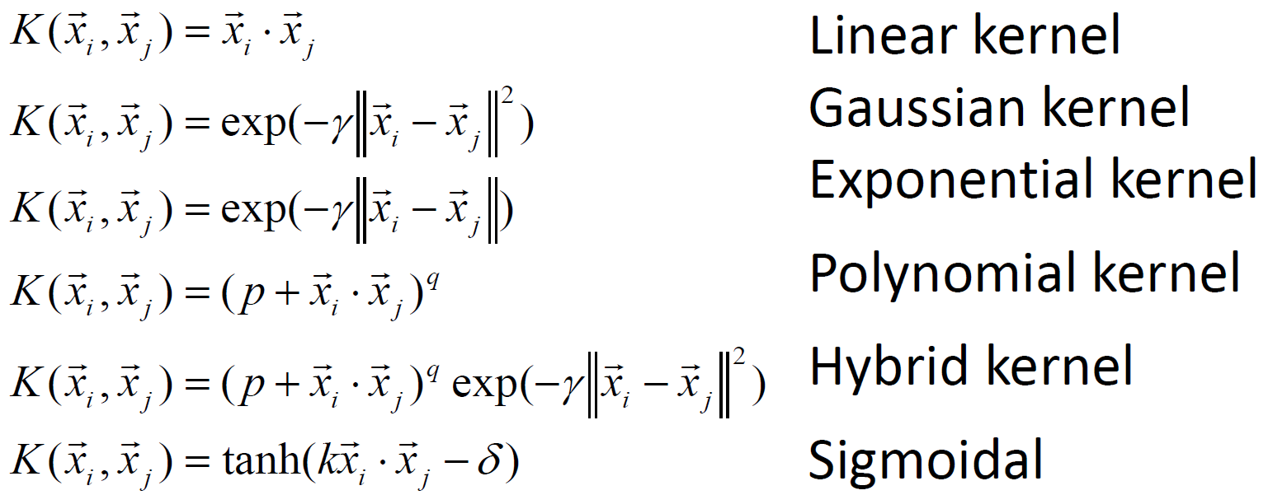
Popular Kernels

Slide 12
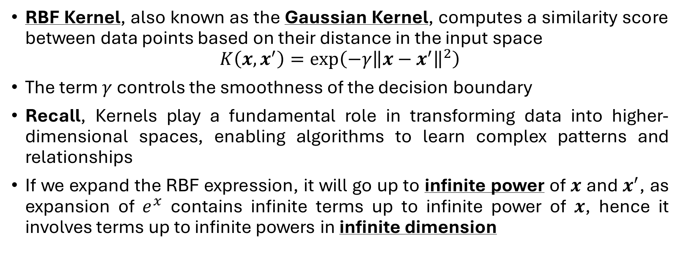
Kernel Trick Using Radial Basis Function (RBF)
RBF Kernel, also known as the Gaussian Kernel, computes a similarity score between data points based on their distance in the input space
$$K\left(x,x^{′}\right)=\exp\left(−γ{\left\|x−x^{′}\right\|}^{2}\right)$$
The term $γ$ controls the smoothness of the decision boundary
Recall, Kernels play a fundamental role in transforming data into higher-dimensional spaces, enabling algorithms to learn complex patterns and relationships
If we expand the RBF expression, it will go up to infinite power of $x$ and $x^{′}$, as expansion of $e^{x}$ contains infinite terms up to infinite power of $x$, hence it involves terms up to infinite powers in infinite dimension

Slide 13
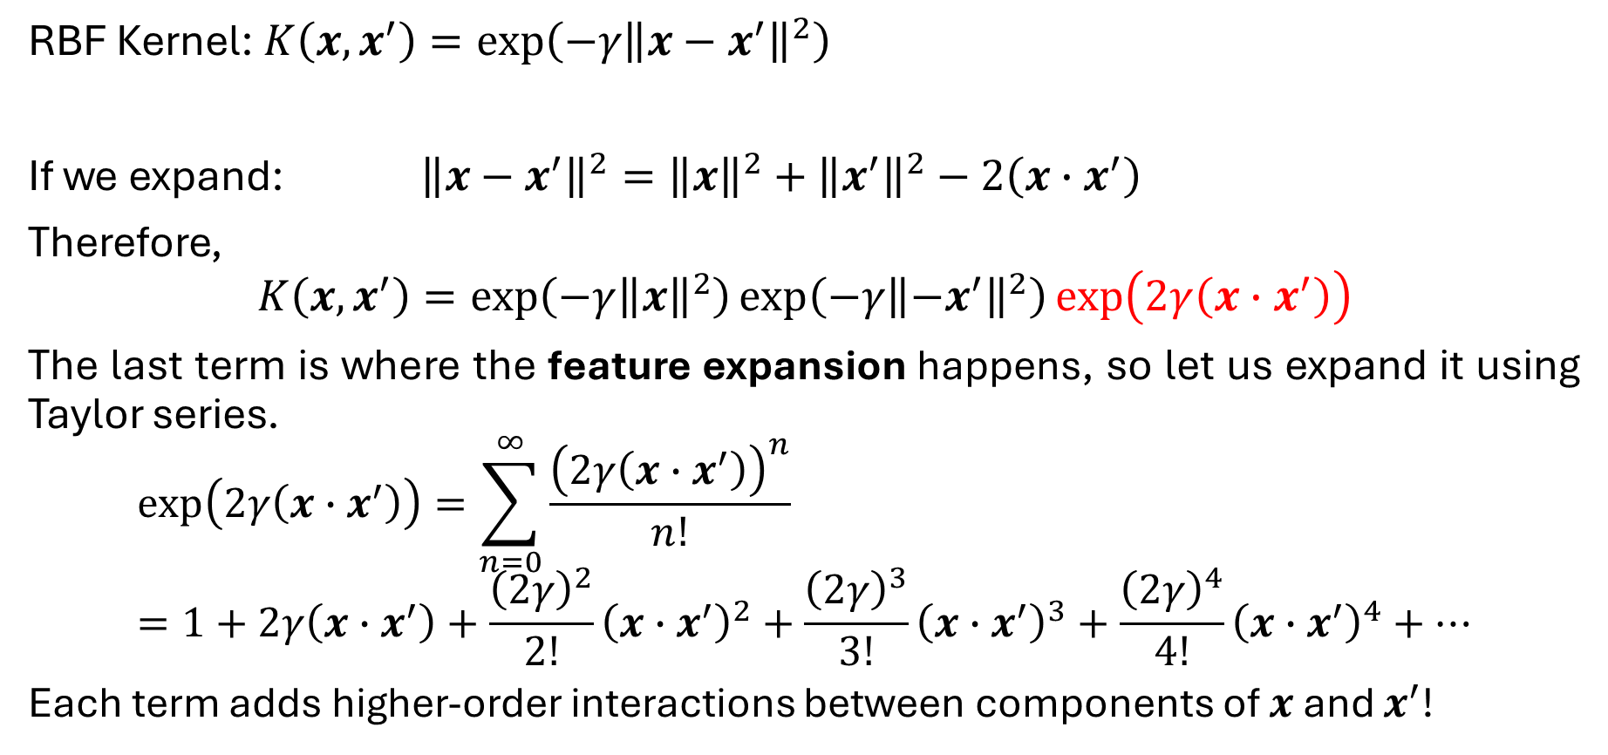
RBF Expansion using Taylor Series
RBF Kernel: $K\left(x,x^{′}\right)=\exp\left(−γ{\left\|x−x^{′}\right\|}^{2}\right)$
If we expand: ${\left\|x−x^{′}\right\|}^{2}={\left\|x\right\|}^{2}+{\left\|x^{′}\right\|}^{2}−2\left(x∙x^{′}\right)$
Therefore,
$$K\left(x,x^{′}\right)=\exp\left(−γ{\left\|x\right\|}^{2}\right)\exp\left(−γ{\left\|−x^{′}\right\|}^{2}\right)\exp\left(2γ\left(x∙x^{′}\right)\right)$$
The last term is where the feature expansion happens, so let us expand it using Taylor series.
$$\exp\left(2γ\left(x∙x^{′}\right)\right)=\sum_{n=0}^{∞}{\frac{{\left(2γ\left(x∙x^{′}\right)\right)}^{n}}{n!}}=1+2γ\left(x∙x^{′}\right)+\frac{{\left(2γ\right)}^{2}}{2!}{\left(x∙x^{′}\right)}^{2}+\frac{{\left(2γ\right)}^{3}}{3!}{\left(x∙x^{′}\right)}^{3}+\frac{{\left(2γ\right)}^{4}}{4!}{\left(x∙x^{′}\right)}^{4}+…$$
Each term adds higher-order interactions between components of $x$ and $x^{′}$!

Slide 14
Why this matters?
This makes it clear that the RBF kernel implicitly includes all polynomial kernels:
No need to compute or store any of these polynomial features explicitly
The result is an infinite-dimensional feature space
Yet, evaluation is fast because you are just computing a single exponential!

Slide 15
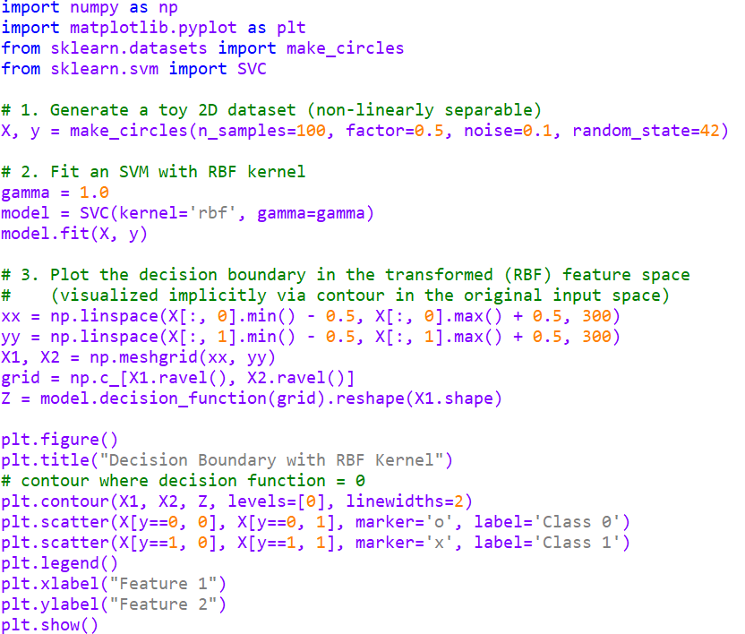
Example Code

Slide 16
Example Code: Result

